Slide 1
Session -7 Software Re-engineering

Slide 2
Recap for session 6
Software Maintenance
Types of Software Maintenance
Cost of Software Maintenance
Maintenance Activities

Slide 3
Agenda for session 7
Software Re-Engineering
The need of software Re-engineering
Re-engineering Cost Factor
Software Re-Engineering Activities
Re-engineering Process
Reuse
Advantages of Re-engineering
Disadvantages of Re-engineering

Slide 4
Software Re-engineering
Software Re-engineering is a process of software development which is done to improve the maintainability of a software system.
When we need to update the software to keep it to the current market, without impacting its functionality, it is called software re-engineering. It is a thorough process where the design of software is changed and programs are re-written.
3 Legacy software cannot keep tuning with the latest technology available in the market. As the hardware become obsolete, updating of software becomes a headache. Even if software grows old with time, its functionality does not.
4. For example, initially Unix was developed in assembly language. When language C came into existence, Unix was re-engineered in C, because working in assembly language was difficult.

Slide 5
The need of software Re-engineering
Software re-engineering is an economical process for software development and quality enhancement of the product.
This process enables us to identify the useless consumption of deployed resources and the constraints that are restricting the development process so that the development process could be made easier and cost-effective (time, financial, direct advantage, optimize the code, indirect benefits, etc.) and maintainable.

Slide 6
The need of software Re-engineering (Cont..)
Boost up productivity: Software reengineering increase productivity by optimizing the code and database so that processing gets faster.
Processes in continuity: The functionality of older software product can be still used while the testing or development of software.

Slide 7
The need of software Re-engineering (cont..)
c) Improvement opportunity: Meanwhile the process of software reengineering, not only software qualities, features and functionality but also your skills are refined, new ideas hit in your mind. This makes the developers mind accustomed to capturing new opportunities so that more and more new features can be developed.
d) Reduction in risks: Instead of developing the software product from scratch or from the beginning stage here developers develop the product from its existing stage to enhance some specific features that are brought in concern by stakeholders or its users. Such kind of practice reduces the chances of fault fallibility.

Slide 8
The need of software Re-engineering (cont…)
e) Saves time: As we stated above here that the product is developed from the existing stage rather than the beginning stage so the time consumes in software engineering is lesser.
f) Optimization: This process refines the system features, functionalities and reduces the complexity of the product by consistent optimization as maximum as possible.

Slide 9
Re-Engineering cost factors:
The quality of the software to be re-engineered.
The tool support availability for engineering.
The extent of the data conversion which is required.
The availability of expert staff for Re-engineerin

Slide 10
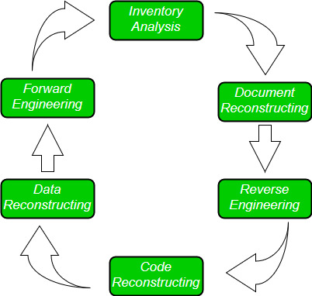
Software Re-Engineering Activities:

Slide 11
Software Re-Engineering Activities: (Cont…)
Inventory Analysis:
Every software organisation should have an inventory of all the applications.
Inventory can be nothing more than a spreadsheet model containing information that provides a detailed description of every active application.
By sorting this information according to business criticality, longevity, current maintainability and other local important criteria, candidates for re-engineering appear.
The resource can then be allocated to a candidate application for re-engineering work.

Slide 12
Software Re-Engineering Activities: (Cont…)
2. Document reconstructing:
Documentation of a system either explains how it operates or how to use it.
Documentation must be updated.
It may not be necessary to fully document an application.
The system is business-critical and must be fully re-documented.

Slide 13
Software Re-Engineering Activities: (Cont…)
3. Reverse Engineering:
Reverse engineering is a process of design recovery. Reverse engineering tools extract data, architectural and procedural design information from an existing program.

Slide 14
Software Re-Engineering Activities: (Cont…)
4. Code Reconstructing:
To accomplish code reconstructing, the source code is analysed using a reconstructing tool. Violations of structured programming construct are noted and code is then reconstructed.
The resultant restructured code is reviewed and tested to ensure that no anomalies have been introduced.

Slide 15
Software Re-Engineering Activities: (Cont…)
5. Data Restructuring:
Data restructuring begins with a reverse engineering activity.
Current data architecture is dissected, and the necessary data models are defined.
Data objects and attributes are identified, and existing data structure are reviewed for quality.

Slide 16
Software Re-Engineering Activities: (Cont…)
6. Forward Engineering:
Forward Engineering also called as renovation or reclamation not only for recovers design information from existing software but uses this information to alter or reconstitute the existing system in an effort to improve its overall quality.

Slide 17
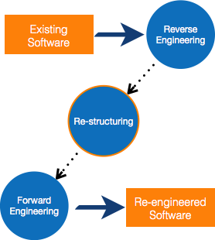
Software Re-engineering Cont…
Other than this, sometimes programmers notice that few parts of software need more maintenance than others and they also need re-engineering.

Slide 18
RE-ENGINEERING PROCESS
Decide what to re-engineer. Is it whole software or a part of it?
Perform Reverse Engineering, in order to obtain specifications of existing software.
Restructure Program if required. For example, changing function-oriented programs into object-oriented programs.
Re-structure data as required.
Apply Forward engineering concepts in order to get re-engineered software.

Slide 19
Component reusability
RE-ENGINEERING PROCESS (cont…
A component is a part of software program code, which executes an independent task in the system. It can be a small module or sub-system itself.
EXAMPLE
The login procedures used on the web can be considered as components, printing system in software can be seen as a component of the software.
Components have high cohesion of functionality and lower rate of coupling, i.e. they work independently and can perform tasks without depending on other modules.
In OOP, the objects are designed are very specific to their concern and have fewer chances to be used in some other software.
In modular programming, the modules are coded to perform specific tasks which can be used across number of other software programs.
There is a whole new vertical, which is based on re-use of software component, and is known as Component Based Software Engineering (CBSE).

Slide 20
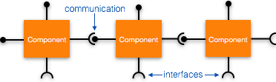
EXAMPLE cont…
RE-ENGINEERING PROCESS (cont…
Re-use can be done at various levels
Application level -
Where an entire application is used as sub-system of new software.
Component level -
Where sub-system of an application is used.
Modules level -
Where functional modules are re-used.
Software components provide interfaces, which can be used to establish communication among different components.

Slide 21
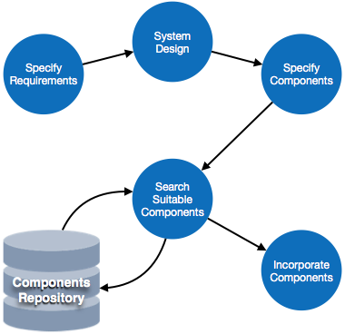
REUSE PROCESS
Two kinds of method can be adopted: either by keeping requirements same and adjusting components or by keeping components same and modifying requirements.

Slide 22
REUSE PROCESS
Requirement Specification - The functional and non-functional requirements are specified, which a software product must comply to, with the help of existing system, user input or both.
Design - This is also a standard SDLC process step, where requirements are defined in terms of software parlance. Basic architecture of system as a whole and its sub-systems are created.
Specify Components - By studying the software design, the designers segregate the entire system into smaller components or sub-systems. One complete software design turns into a collection of a huge set of components working together.
Search Suitable Components - The software component repository is referred by designers to search for the matching component, on the basis of functionality and intended software requirements..
Incorporate Components - All matched components are packed together to shape them as complete software.

Slide 23
Advantages of Re-engineering:
Reduced Risk: As the software is already existing, the risk is less as compared to new software development. Development problems, staffing problems and specification problems are the lots of problems which may arise in new software development.
Reduced Cost: The cost of re-engineering is less than the costs of developing new software.
Revelation of Business Rules: As a system is re-engineered , business rules that are embedded in the system are rediscovered.
Better use of Existing Staff: Existing staff expertise can be maintained and extended accommodate new skills during re-engineering.

Slide 24
Disadvantages of Re-engineering
:
Practical limits to the extent of re-engineering.
Major architectural changes or radical reorganizing of the systems data management has to be done manually.
Re-engineered system is not likely to be as maintainable as a new system developed using modern software Re-engineering methods.

Slide 25
Questions
Sometimes programmers notice that few parts of software need more maintenance than others and they also need re-engineering. Explain with figure
Write about RE-ENGINEERING PROCESS
3. Write about REVERSE ENGINEERING
4. Re-use can be done at various levels
5. Explain these terms?
Requirement Specification -.
Design -
Specify Components -
Search Suitable Components -
Incorporate Components -

